Slide 1
A 501(c)(3) charitable organization

Slide 2
Ways to Donate
Check made out to
David W. Smith Fund, Inc.
From your IRA
Direct bank transfer
(LMB can provide account information)
Amazon Smile
Paypal through website (-3%)

Slide 3
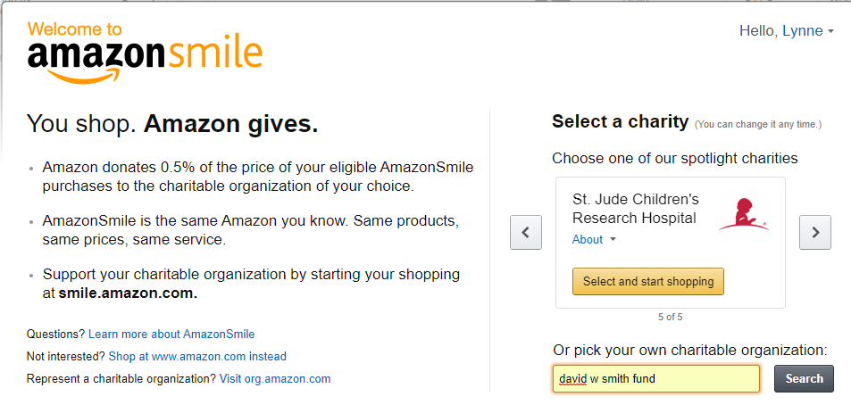
https://smile.amazon.com/

Slide 4
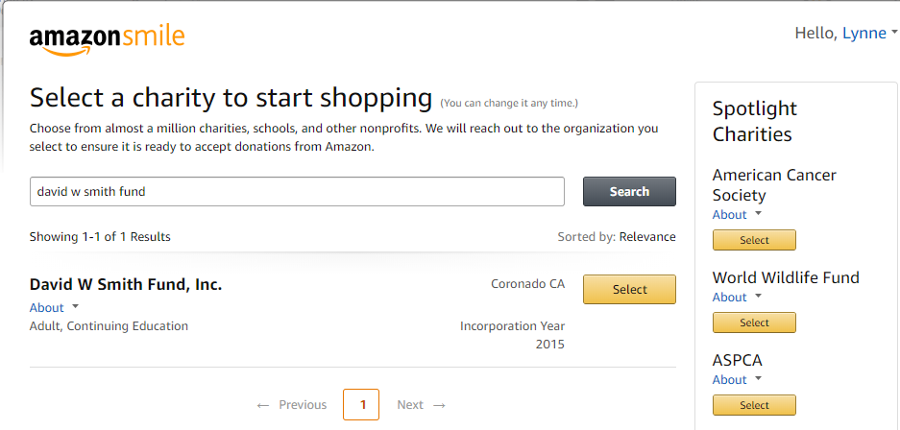
https://smile.amazon.com/

Slide 5
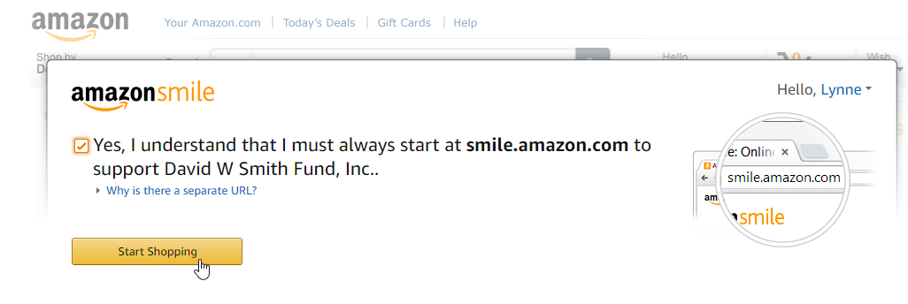
https://smile.amazon.com/

Slide 6
DWSmith.org

Slide 8
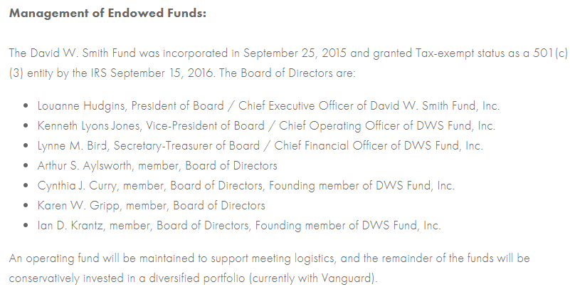
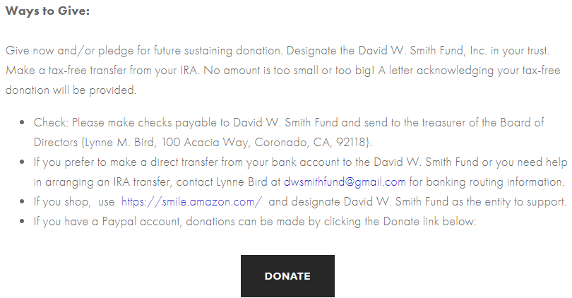

Slide 9
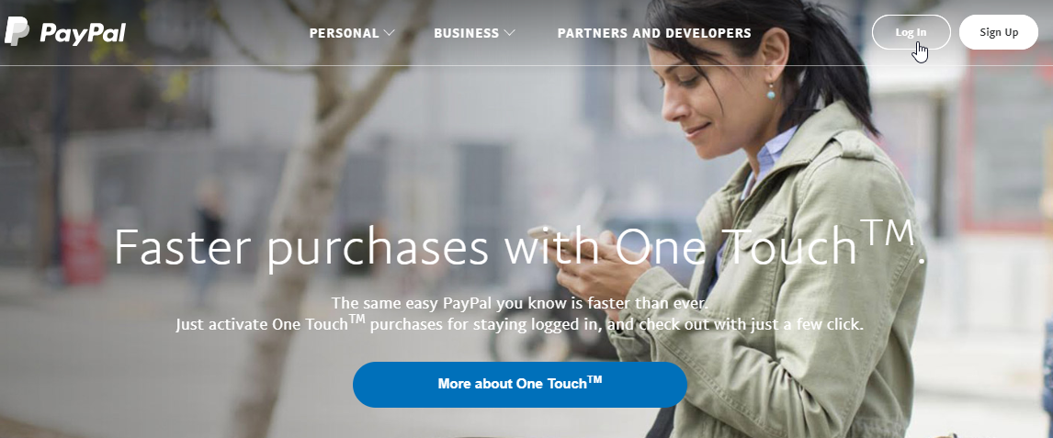
Step 1. Log in to your paypal account

Slide 10
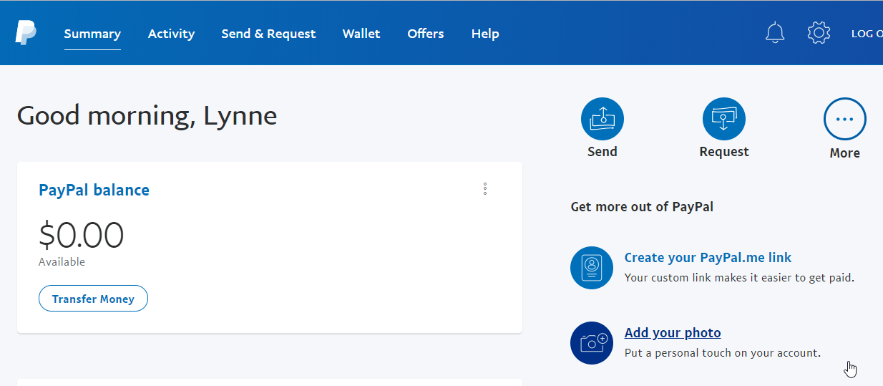
Step 2. Choose the option to Send Money

Slide 11
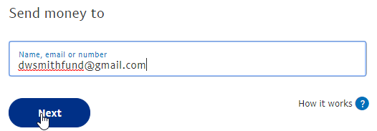
Step 3. Enter the Email address of the DWS Fund

Slide 12
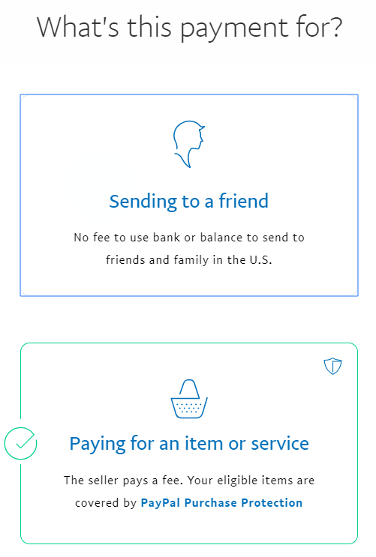
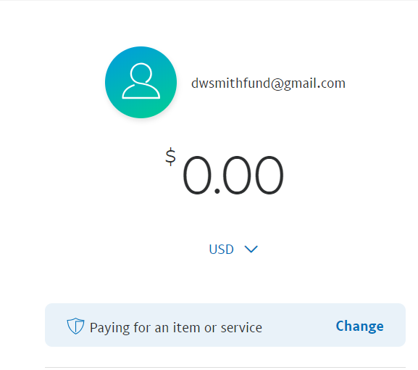
Step 4. Change “paying for an item or service” to “Sending to a friend”

Slide 13
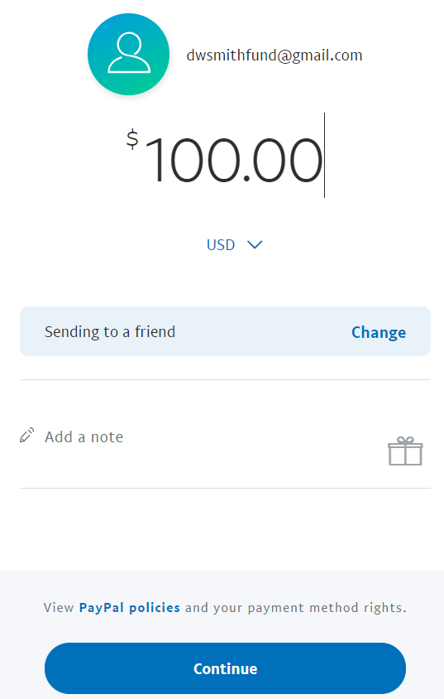
Step 5. Enter donation amount and continue

Slide 14
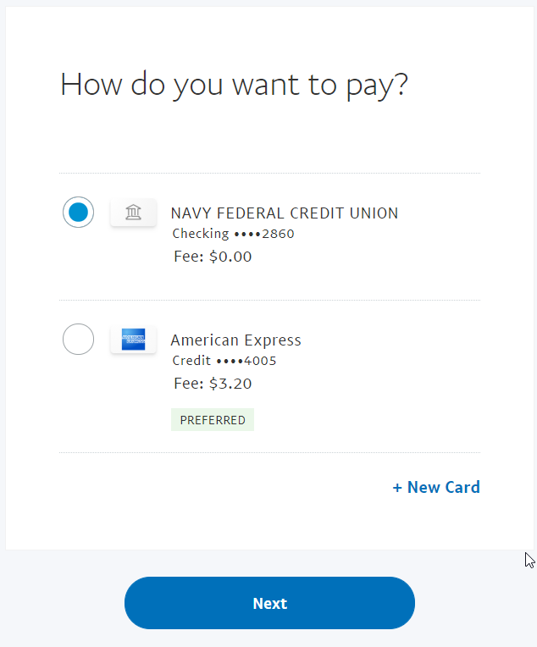
Step 6. Choose how you want to pay – if it comes directly from your bank account, the Fund pays no fees. If the donation is charged to your credit card, the Fund pays a fee. Click Next.

Slide 15
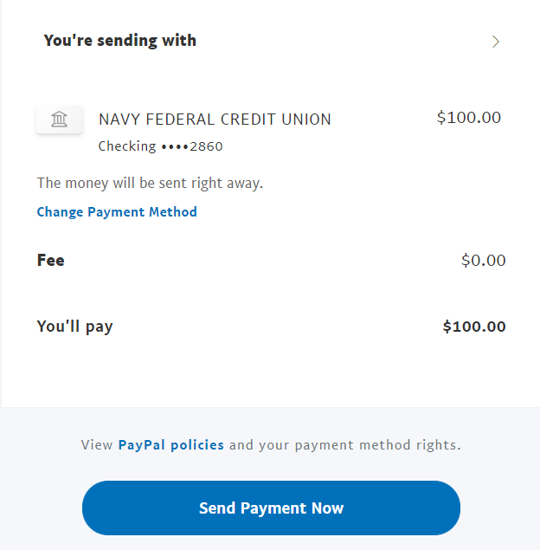
Step 7. Click “Send Payment Now”

